Slide 1


Insights on Life Satisfaction
Data Analytics and Visualization
Final Project
Ajay Vishnu Addala
Kireeti Mantrala

Slide 2

Introduction
Individual utility, or subjective well-being, has been an object of economic studies for a long time.
We draw different visuals in this presentation to visualize and understand the dependency of multiple factors on Life Satisfaction.

Slide 3
Data collection
Data were collected from 4 different sections of our world data.
Data has been collated from all 18 datasets collected and then cleaned based on the insights we wanted to focus on.
Further, the variables that have been considered have been shown next.

Slide 4
Data Variables
Country
Country Code
Continent
Year
GDP per capita
Population
GNI per capita
Annual working hours per person
Productivity
Life Satisfaction
Human Development Index
Urban population%

Slide 5
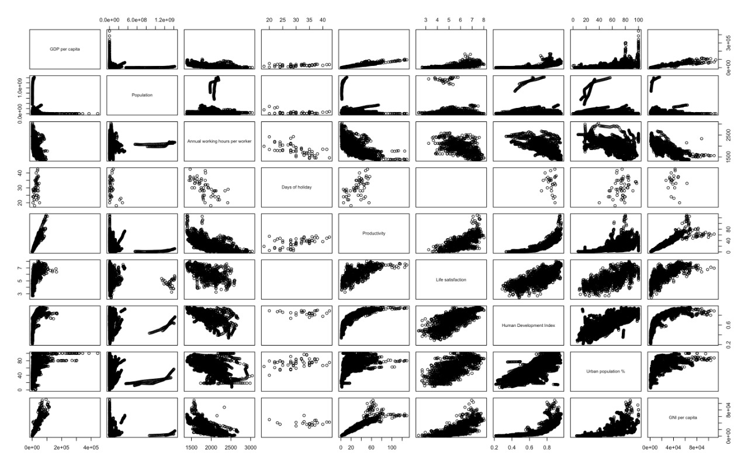
Correlation plot

Slide 6
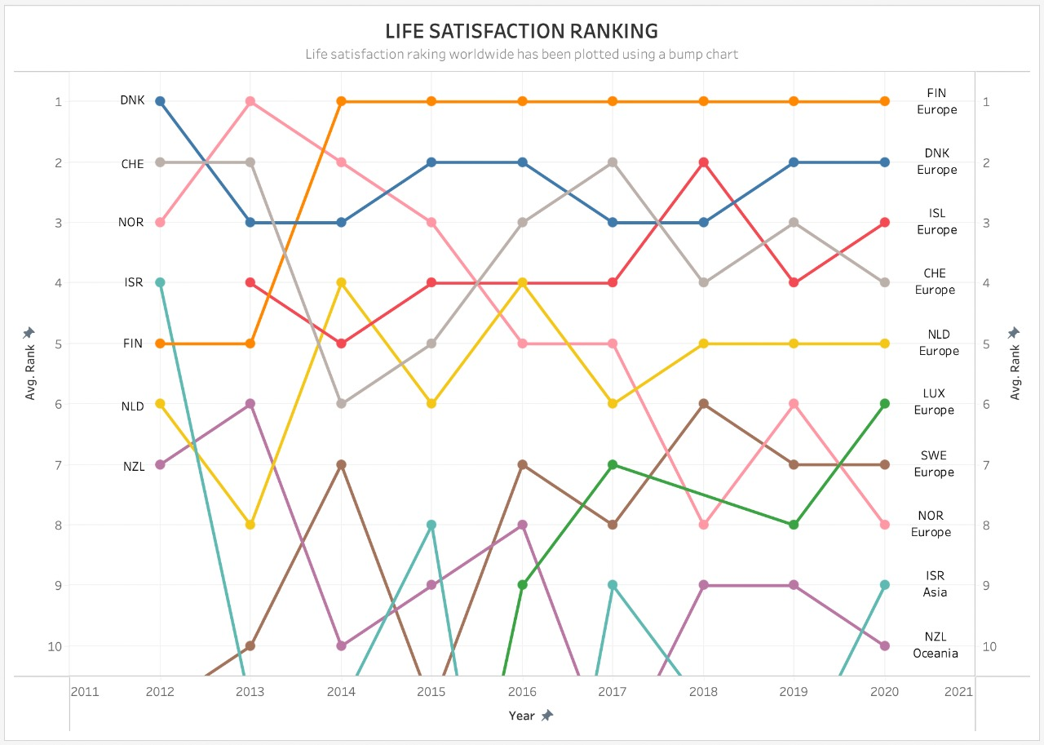
Bump Chart – Life Satisfaction Ranking
EUROPE

Slide 7
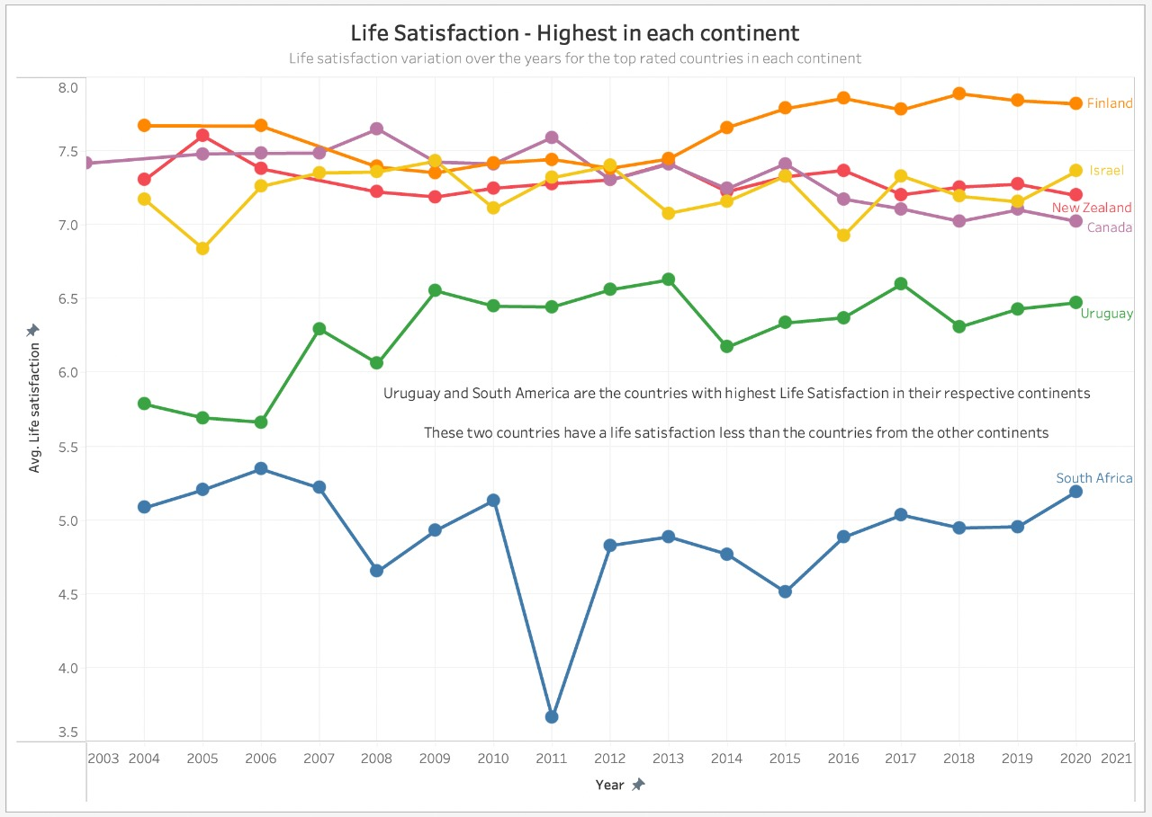
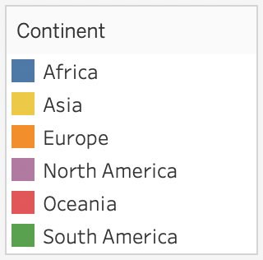
Line Chart – Life Satisifaction
All 4 countries showed
similar Life satisfaction

Slide 8
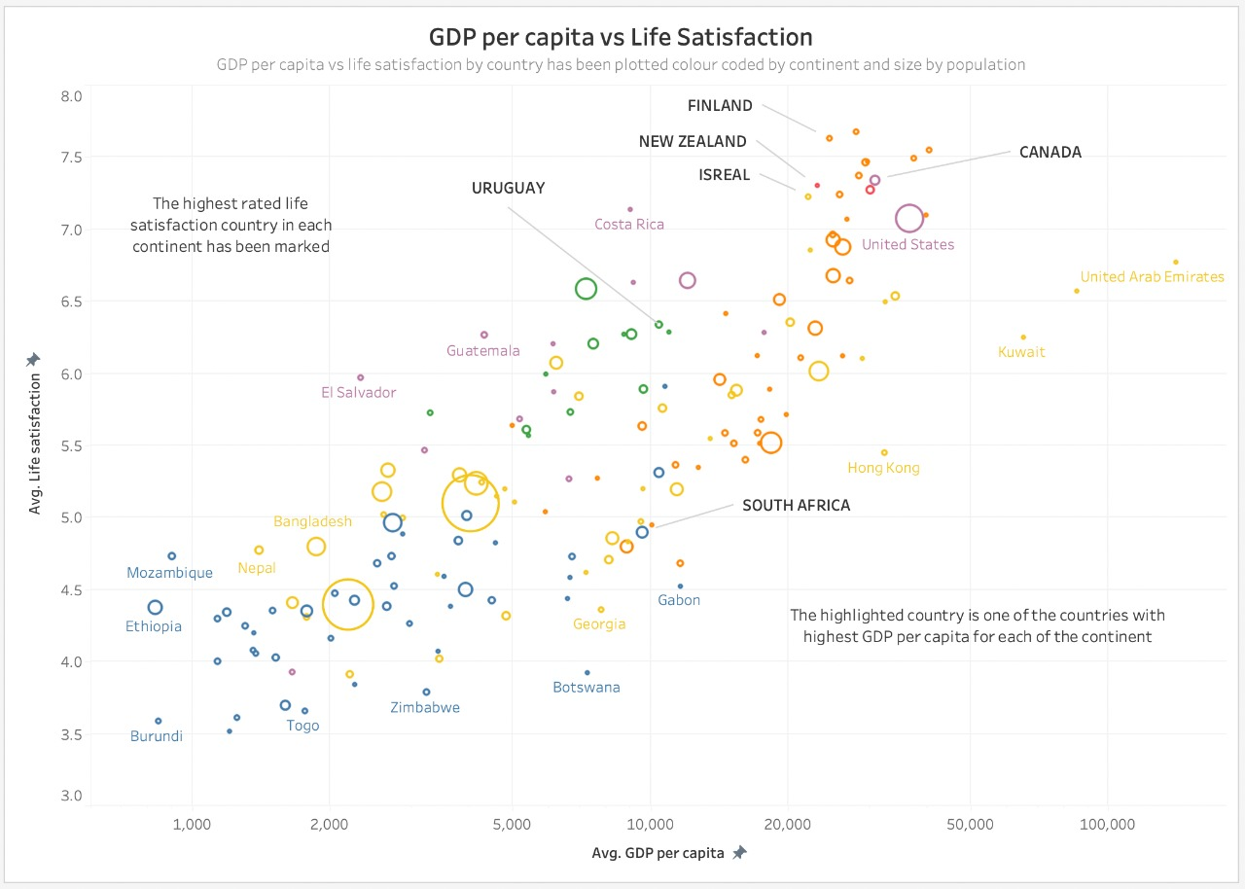
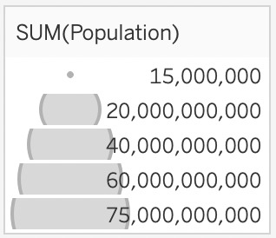
Bubble Chart – GDP per capita vs Life Satisfaction

Slide 9
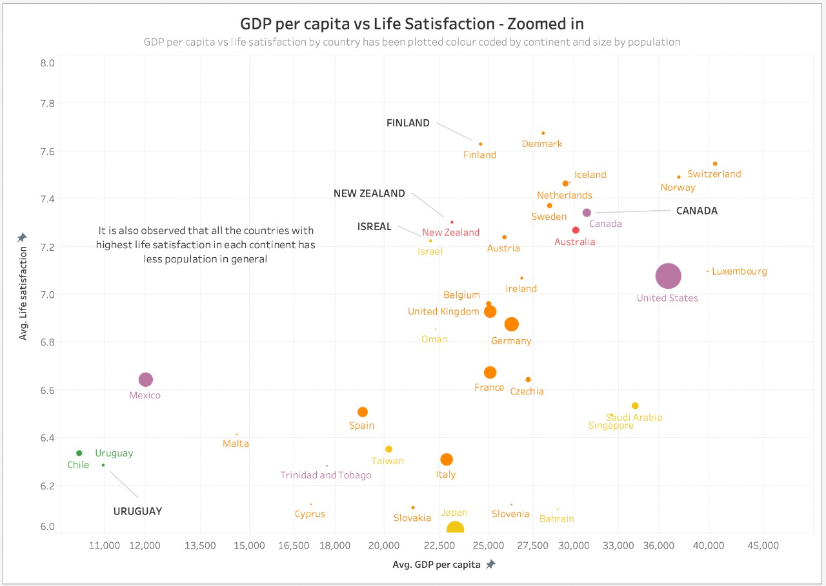
Closer look at selected countries

Slide 10
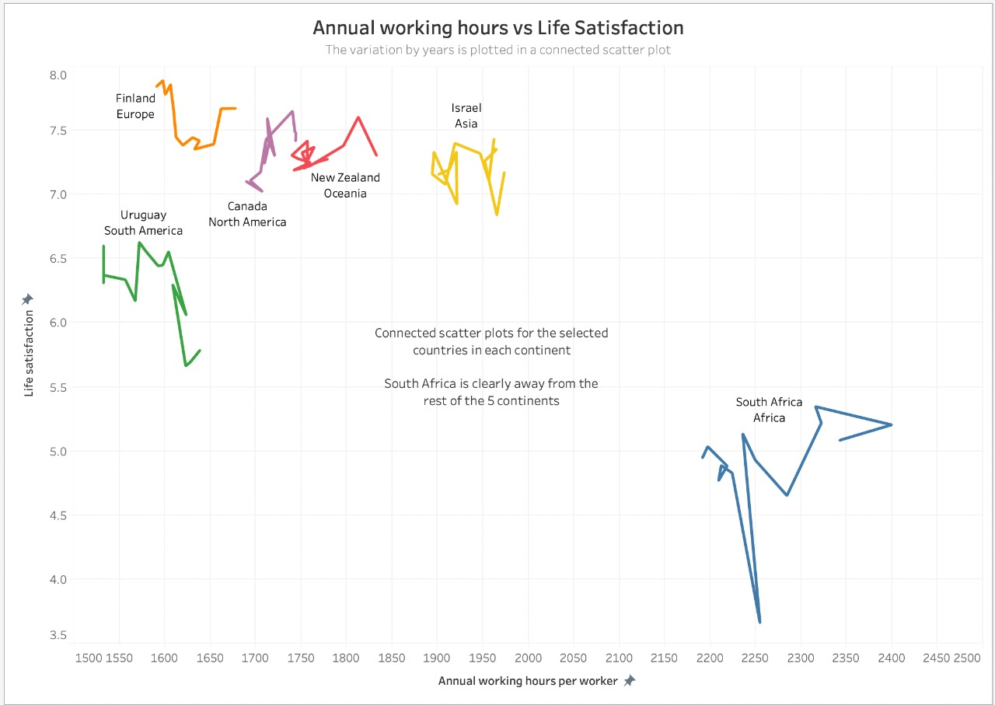
Connected Scatter plot – Annual working hours vs Life Satisfaction

Slide 11
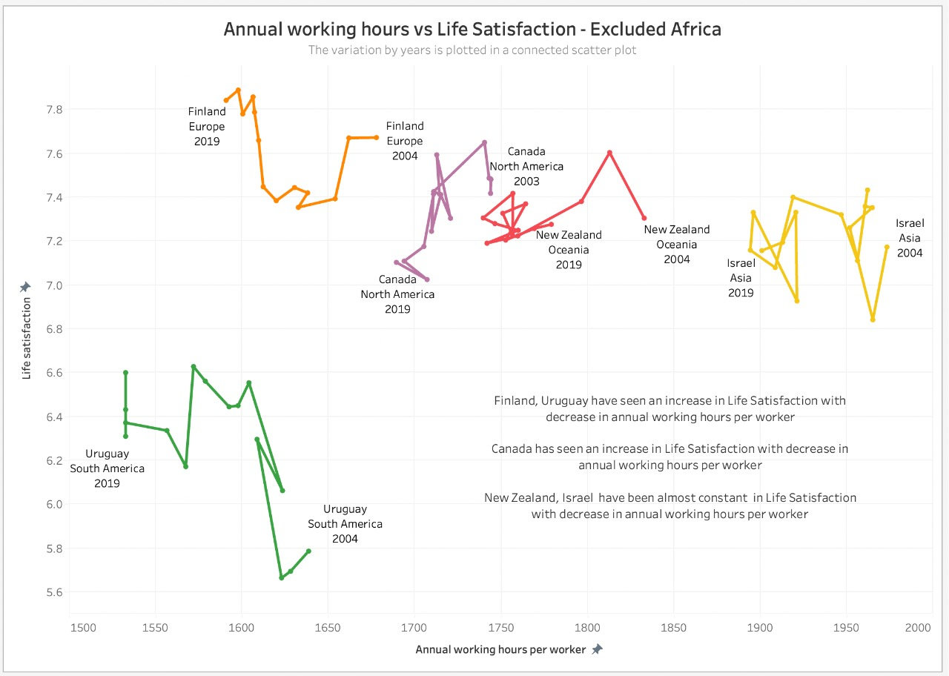
Connected scatterplot without South Africa

Slide 12
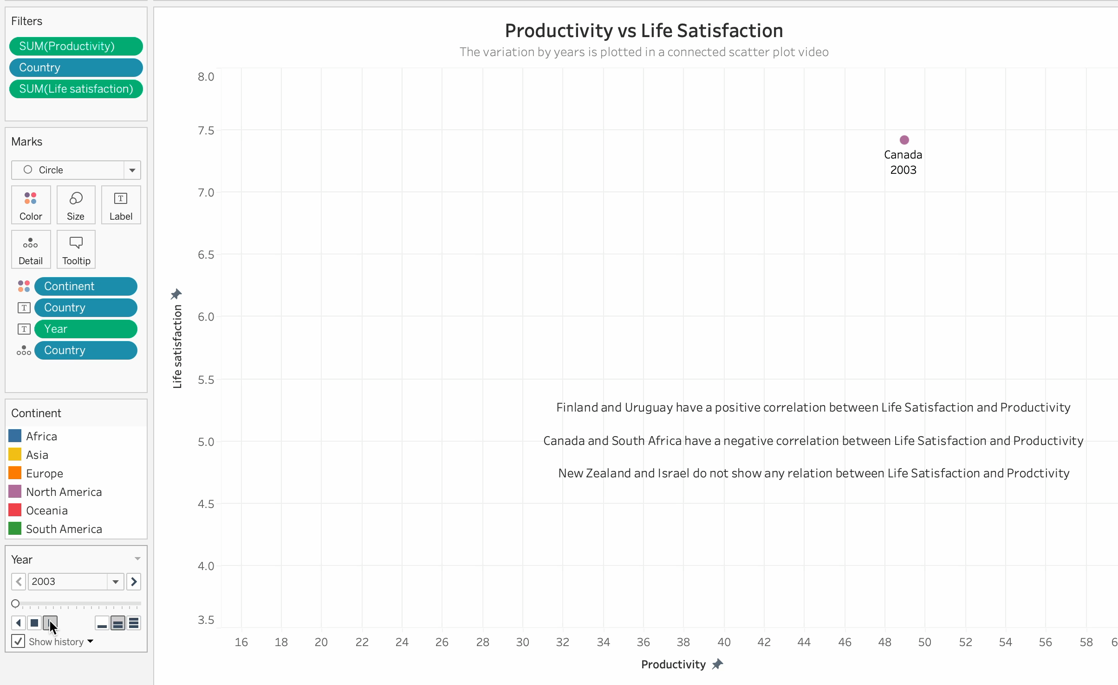
Connected scatterplot - Interactive

Slide 13
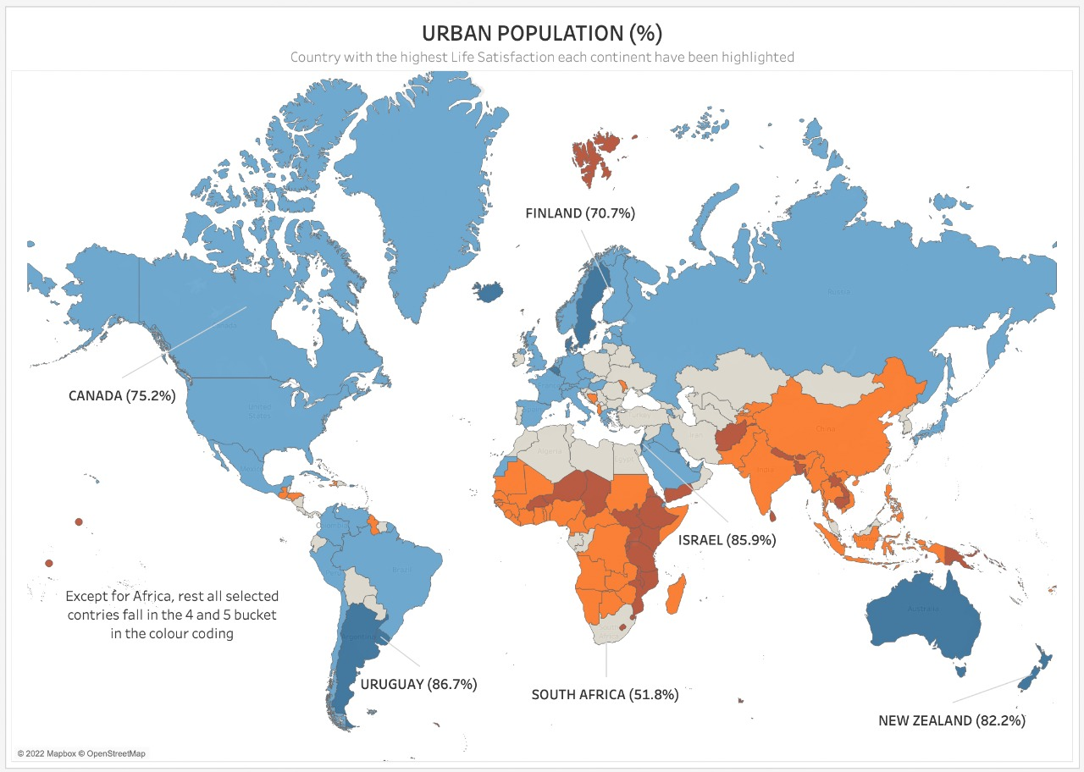
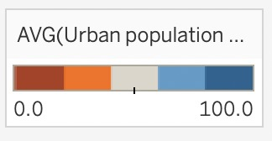
World map depicting Urban Population percentage
All six selected countries have the highest urban population % in their respective countries

Slide 14
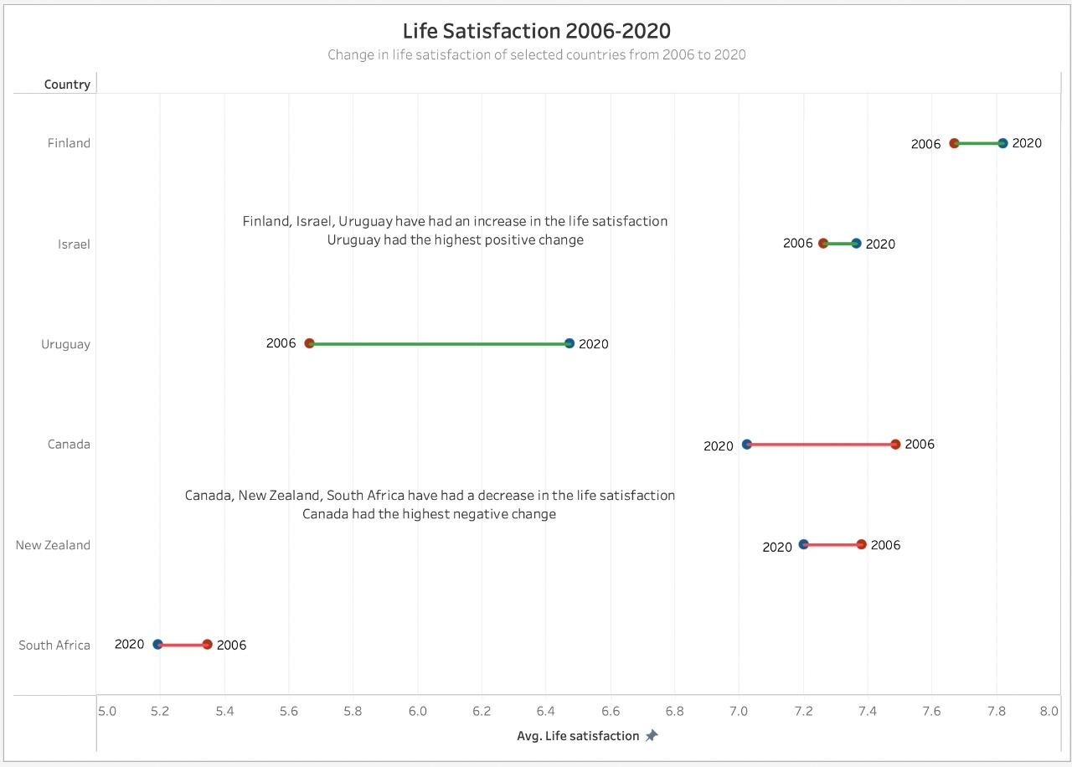
Dumbell chart – Average Life Satisfaction
INCREASE
DECREASE

Slide 15
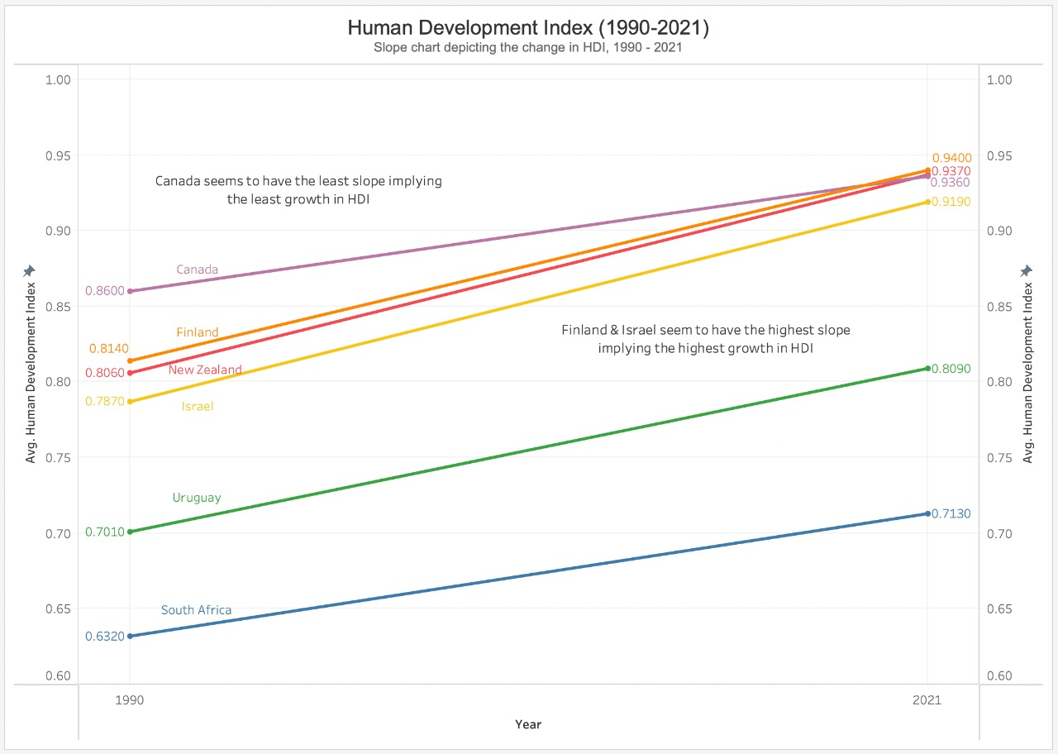
Slope Chart – Human Development Index

Slide 16
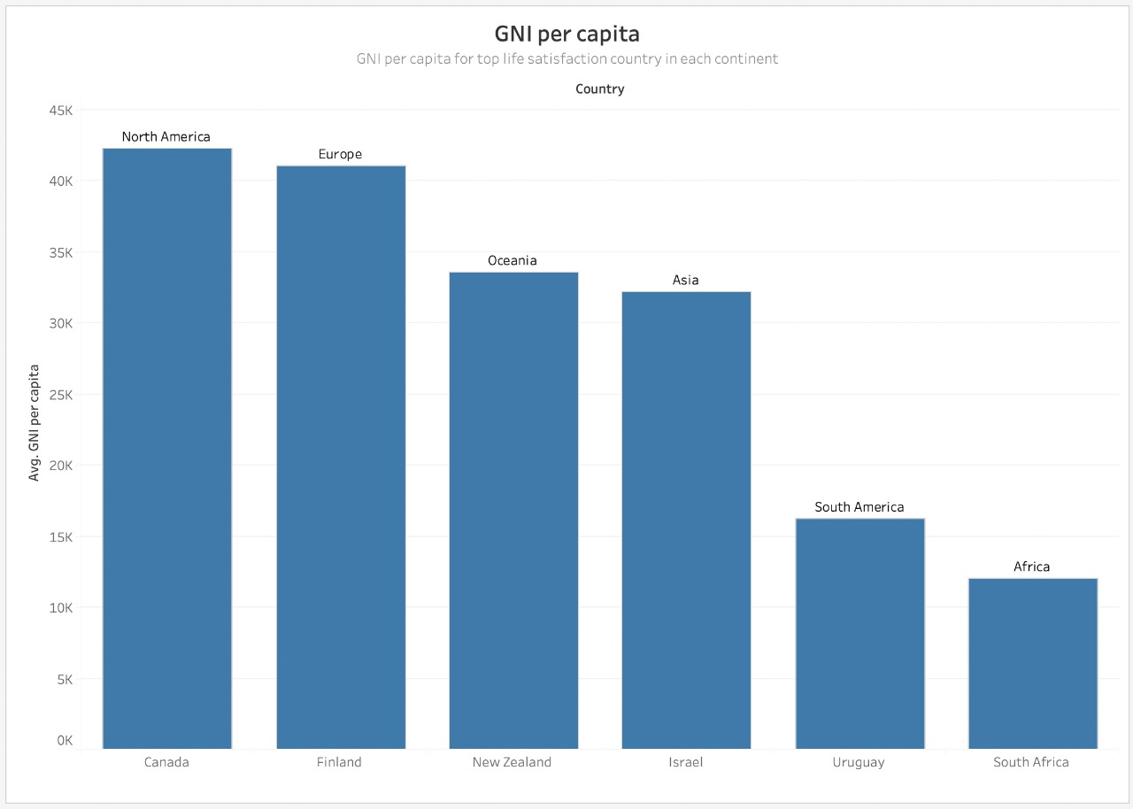
Bar Chart – GNI per capita

Slide 17
Conclusion
Initial data was analyzed, and the highest life satisfaction-rated country from each continent was considered by analysis.
South America and Africa have lower life satisfaction scores than the other continents.
The countries with the highest life satisfaction have the highest GDP per capita in their respective continents.
The countries with the highest life satisfaction fell in the highest urban population % bucket in their respective countries.
Finland, Israel, and Uruguay have had an increase in life satisfaction. Uruguay had the most significant positive change.
Canada, New Zealand, and South Africa have had a decrease in life satisfaction.

Slide 18
Thank you!
Any Suggestions?
Keep Visualizing.
Happy Holidays!
Don’t miss the World Cup final this Sunday!
VAMOS ARGENTINA! 🇦🇷💙

